Slide 1

Introduction to Linux
“Linux at the Command Line”
Prof. (Dr.) Firoj Parwej
Notes:
Tux source: http://upload.wikimedia.org/wikipedia/commons/thumb/a/af/Tux.png/220px-Tux.png

Slide 2
About the class…
We’ll start with a sign in sheet that include questions about your Linux experience and goals.
We’ll end with a class evaluation.
We’ll cover as much as we can in the time allowed, starting with the easiest and most important material. Don’t feel rushed; if we don’t cover everything, you’ll pick it up as you continue working with Linux.
This is a hands-on, lab class; ask questions at any time.
Commands for you to type are in BOLD
We’ll take a break at the half-way point.

Slide 3
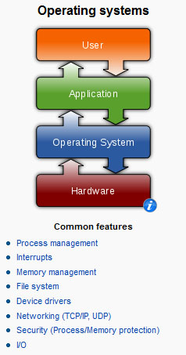
What is Linux?
It’s an Operating System
Notes:
Operating systems graphic source: http://en.wikipedia.org/wiki/Operating_system

Slide 4


What is Linux?
The Most Common O/S Used By BU Researchers When Working on a Server or Computer Cluster
Notes:
Einstein at computer source: http://www.freakingnews.com/Pictures/1/IBM-PC-turns-25.jpg
BU Rhett logo source: http://content.sportslogos.net/logos/30/619/full/71v3tk2fyob03vry9halsekcg.gif

Slide 5
What is Linux?
Linux is a Unix clone written from scratch by Linus Torvalds with assistance from a loosely-knit team of hackers across the Net.
Unix is a multitasking, multi-user computer operating system originally developed in 1969 by a group of AT&T employees at Bell Labs.
Linux and Unix strive to be POSIX compliant.
64% of the world’s servers run some variant of Unix or Linux. The Android phone and the Kindle run Linux.
Notes:
What is Linux? source: http://www.kernel.org/pub/linux/kernel/README and http://en.wikipedia.org/wiki/Linux and http://en.wikipedia.org/wiki/Unix
POSIX an acronym for "Portable Operating System Interface", is a family of standards specified by the IEEE for maintaining compatibility between operating systems. POSIX defines the application programming interface (API), along with command line shells and utility interfaces, for software compatibility with variants of Unix and other operating systems (source: http://en.wikipedia.org/wiki/POSIX).

Slide 6
The Linux Philosophy
The *Nix Philosophy of Doug McIlroy
(i) Make each program do one thing well. To do a new job, build afresh rather than complicate old programs by adding new features.
(ii) Expect the output of every program to become the input to another, as yet unknown, program. Don't clutter output with extraneous information. Avoid stringently columnar or binary input formats. Don't insist on interactive input.
(iii) Use tools in preference to unskilled help to lighten a programming task, even if you have to detour to build the tools and expect to throw some of them out after you've finished using them.
Notes:
Source: http://www.faqs.org/docs/artu/ch01s06.html

Slide 7

Linux Has Many Distributions
Notes:
Logos source: http://www.muylinux.com/wp-content/uploads/2009/04/logos-distros.jpg

Slide 8

Linux Has Many Distributions
BU uses CentOS in its Linux cluster which is a free version of RedHat Enterprise Linux with the trademarks removed
Notes:
Logo source: http://uk2host.com/i/centos.gif

Slide 9

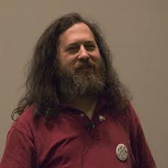
What is Linux? Linux + GNU Utilities = Free Unix
a set of small programs written by Richard Stallman and others. They are the GNU utilities.
http://www.gnu.org/
Linux is an O/S core written by Linus Torvalds and others AND
Notes:
Richard Stallman source: http://www.stuffyouwillhate.com/wp-content/uploads/richard-stallman.jpg
Linux Torvalds source: https://netfiles.uiuc.edu/rhasan/linux/Linus_Torvalds.jpg

Slide 10
What is Linux? “Small programs that do one thing well” (see unix-reference.pdf)
Network: ssh, scp, ping, telnet, nslookup, wget
Shells: BASH, TCSH, alias, watch, clear, history, chsh, echo, set, setenv, xargs
System Information: w, whoami, man, info, which, free, echo, date, cal, df, free, man, info
Command Information: man, info
Symbols: |, >, >>, <, &, >&, 2>&1, ;, ~, ., .., $!, !:<n>, !<n>
Filters: grep, egrep, more, less, head, tail
Hotkeys: <ctrl><c>, <ctrl><d>
File System: ls, mkdir, cd, pwd, mv, ln, touch, cat, file, find, diff, cmp, /net/<hostname>/<path>, mount, du, df, chmod, find
Line Editors: awk, sed
File Editors: vim, gvim, emacs –nw, emacs

Slide 11
What is Linux? “Small programs that do one thing well”
We will not cover the commands below in this class, but you need to know them. See the man pages for the process commands and the “sge” folder inside of the “cheat sheets and tutorials” folder for the SGE (Sun Grid Engine) command tutorials: qsh-interactive.pdf, qsh-interactive-matlab.pdf, qsub-batch.pdf, qsub-batch-matlab.pdf, and qstat-qhost.pdf.
Process Management: ps, top, kill, killall, fg, bg
SGE Cluster: qsh, qstat, qsub, qhost

Slide 12
Connecting to a Linux Host
You need a “xterm” emulator: software that emulates an “X” terminal and connects using the “SSH” secure shell protocol.
You are sitting at the “client,” either a Windows, Macintosh or even possibly a Linux machine.
You are connecting to a “server,” typically the “head” or “gateway” node of a cluster of computers. You will be working on the head node or submitting jobs to execution nodes, all of them, Linux machines.
You can also connect to a Linux machine by using VNC to get a whole desktop if it’s supported by the server.

Slide 13


Connecting to a Linux Host – Windows Client Software
You need a “xterm” emulation – software that emulates an “X” terminal and that connects using the “SSH” Secure Shell protocol.
Windows
If you don’t need windowing, “putty” is good: http://www.chiark.greenend.org.uk/~sgtatham/putty/download.html
If you need windowing, use StarNet “X-Win32:” http://www.bu.edu/tech/desktop/site-licensed-software/xwindows/xwin32/
Notes:
Windows logo source: http://www.whatthetech.com/blog/wp-content/uploads/2012/03/windows-logo.jpg
X-Win32 logo source: http://m.ts.vcu.edu/kb/images/software-images/X-Win32-12-Splash.JPG

Slide 14


Connecting to a Linux Host – Mac OS X Client Software
Mac OS X
“Terminal” is already installed
Why? Darwin, the system on which Apple's Mac OS X is built, is a derivative of 4.4BSD-Lite2 and FreeBSD. In other words, the Mac is a Unix system!
Notes:
Steve Jobs image source: http://blogs.computerworld.com/sites/computerworld.com/files/u23/steve-jobs.jpg
Apple logo source: http://coreldrawtips.com/images/applebig.jpg

Slide 15


Let the Linux Lab Begin!
Your Instructor Today
The Ideal Lab Facility
Notes:
Lab image source: http://www.sidekickcomicsuk.com/blogs/media/blogs/sidekick//frankenstein_lab.jpg
Frankenstein image source: http://4.bp.blogspot.com/_OcNNOGpvVSI/RyZDUhUpE2I/AAAAAAAAAEU/e-i67sz7_8U/s1600/2007_7young-frankenstein.jpg

Slide 16

Connecting to a Linux Host - Windows Client
X-Win32/X-Config
Wizard
Name: katana
Type: ssh
Host: katana.bu.edu (Off-campus, must include domain “bu.edu” )
Login: <userID>
Password: <password>
Command: Linux
Click “katana” then “Launch”
Accept the host server public key (first time only)

Slide 17
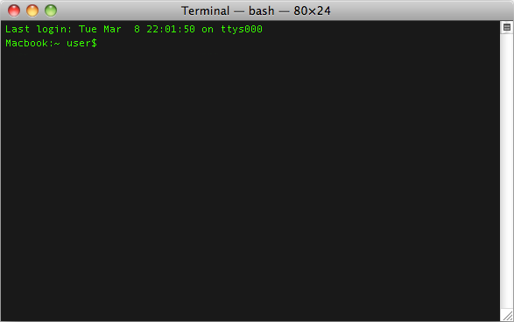

Connecting to a Linux Host - Mac OS X Client
Terminal
Type ssh –X katana.bu.edu or ssh –Y katana.bu.edu (less secure)

Slide 18
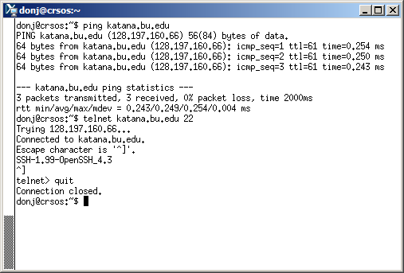
Connection Problems
When there are problems connecting to a login host, try:
ping katana.bu.edu
telnet katana.bu.edu 22

Slide 19
Obtaining the Course Material
Windows
Using File Explorer, copy the directory “\\scv-files.bu.edu\SCV\Training\Introduction to Linux” to “My Documents” on your lab machine
Linux
Connect to katana.bu.edu using X-Win32 and run this command:
cp -Rv /project/ssrcsupp/linux_class ~/

Slide 20
Connecting to a Linux Host: Emulate a Browser
Note: <CR> is short for “carriage return” and equals the ASCII press the “Enter” or “Return” key. It tells the shell that you finished sending one line (see ascii-table.pdf).
Try
telnet www.bu.edu
GET / HTTP/1.1
Host:www.bu.edu<CR>
<CR>
What happened?

Slide 21
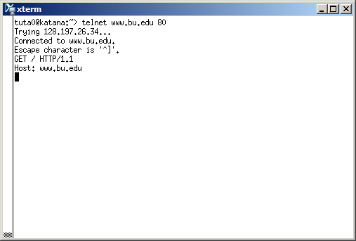
Connecting to a Linux Host
Emulate a Browser

Slide 22
Connecting to a Linux Host: Send and Email
Try
telnet locahost 25
ehlo me
mail from:<your email address>
rcpt to:<destination email address>
data
Subject:<subject of email>
<Body of email>
.
<CR>
What Happened?

Slide 23
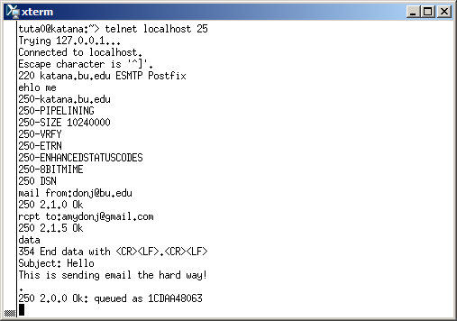
Connecting to an Linux Host
Send and Email

Slide 24
The Shell
A shell is a computer program that interprets the commands you type and sends them to the operating system. Secondly, it provide a programming environment consisting of environment variables.
Most BU systems, including the BU Linux Cluster, support at least two shells: TCSH and BASH. The default shell for your account is TCSH. The most popular and powerful Linux shell today is BASH.
To determine your shell type:
echo $SHELL (shell prints contents of env
echo “$SHELL” (shell still processes env. variable)
echo ‘$SHELL’ (shell treats env. variable as simple literal)
The complete environment can be printed with set, setenv (TCSH) and set (BASH).
To determine the path to the shell program, type:
which bash
which tcsh
Change the shell with “chsh /bin/bash” (provide path to new shell as a “parameter,” meaning to be explained soon)

Slide 25
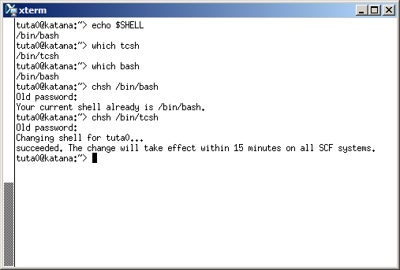
The Shell
Output of the echo, which and chsh commands

Slide 26
System Information
After you connect, type
shazam
whoami
hostname
date
cal
free
Commands have three parts; command, options and parameters. Example: cal –j 3 1999. “cal” is the command, “-j” is an option (or switch), “3” and “1999” are parameters.
Options have long and short forms. Example:
date –u
data --universal
What is the nature of the prompt?
What was the system’s response to the command?

Slide 27
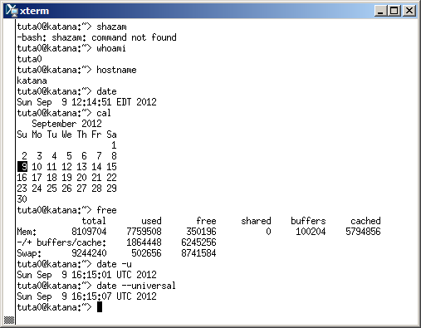
System Information
Output of the whoami, hostname, date, cal and free

Slide 28
Command History and Simple Command Line Editing
Try the history command
Try <Ctrl><r> (only works in BASH shell)
Choose from the command history by using the up ↑ and down ↓ arrows
What do the left ← and right → arrow do on the command line?
Try the <Del> and <Backspace> keys

Slide 29

Help with Commands
Type
hostname –-help
man hostname
info hostname (gives the same or most information, but must be paged)
And “Yes,” you can always Google it
Notes:
Life preserver image source: http://ubesicecreamshop.com/wp-content/uploads/2012/04/life-preserver.jpg

Slide 30
Connect Commands Together with the Pipe Symbol “|” and Using Filters
The pipe “|” feeds the OUTPUT of one command into the INPUT of another command. Our first example will use the pipe symbol to filter the output of a command. Try:
w
w | grep ‘root’
ps -e -o ruser,comm | grep 'tut‘
The ps command is using both “options (dash)” and parameters
Try both “man grep” and “info grep”. See the difference?

Slide 31
Editing the Command Line with Emacs Keys (see emacs-editing-mode.pdf)
<Ctrl-a> go to beginning
<Ctrl-e> go to end
<Alt-f> forward one word
<Alt-b> back one word
<Ctrl-f> forward one character
<Ctrl-b> back one character
<Ctrl-d> delete character
<Alt-d> delete word
<Ctrl-u> delete from cursor to beginning of line
<Ctrl-k> delete from cursor to end of line
See emacs-editing-mode.pdf and emacs-editing-mode-short.pdf
Go to through command history in shell and practice editing.

Slide 32
The Linux File System
The *Nix (Unix or Linux) file system is a hierarchical directory structure
The structure resembles an upside down tree
Directories are collections of files and other directories. The structure is recursive with many levels.
Every directory has a parent except for the root directory.
Many directories have children directories.
Unlike Windows, with multiple drives and multiple file systems, a *Nix system only has ONE file system.
The Linux Standard Base (LSB) specifies the structure of a Linux file system.

Slide 33
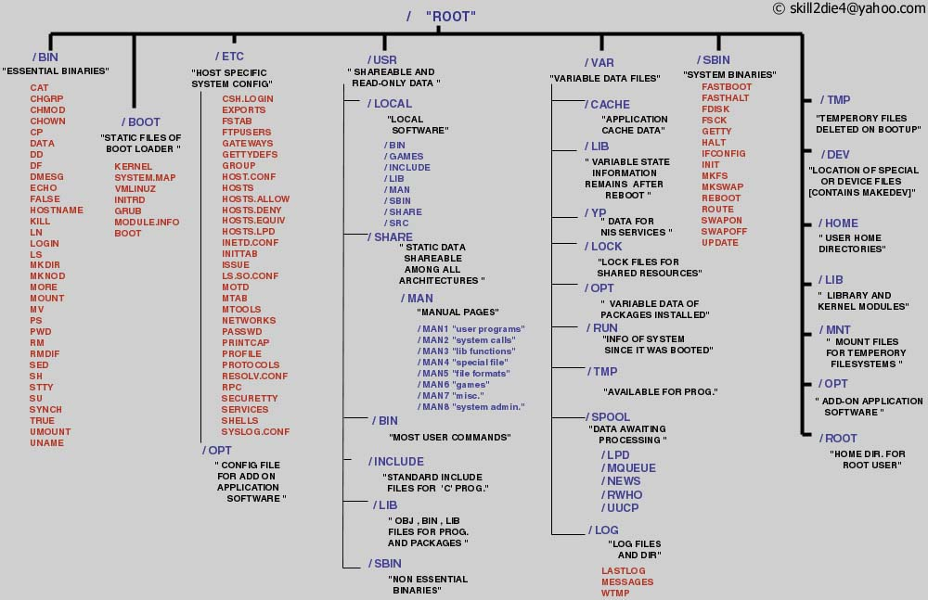
The Linux File System
A Typical Linux File System
Notes:
Source: http://www.tuxmachines.org/images/linux_file_structure.jpg

Slide 34
Examining the File System
Try
nautilus –-browser –-no-desktop
tree –L 3 –d / | less
tree –L 3 / | less
file /bin/alsac then press <tab>
cd ~; pwd (This is your home directory where application settings are kept and where you have write privileges)
ls
mkdir myPics;mkdir myPics/work;mkdir myPics/friends;mkdir myPics/friends/BU; mkdir myPics/friends/MIT
tree myPics

Slide 35
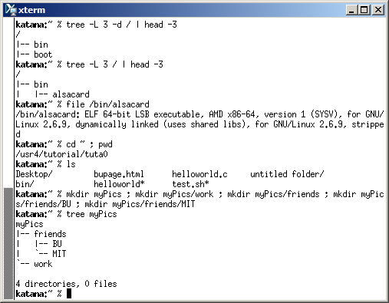
Examining the File System
Output from the tree, file, pwd and ls commands
Demonstration of using the mkdir command

Slide 36
Navigating the File System
There are two types of pathnames
Absolute (Abs) – the full path to a directory or file; begins with the root symbol /
Relative (Rel) – a partial path that is relative to the current working directory
Examples
Abs cd /usr/local/lib
echo $HOME (one of may environment variables maintained by the shell)
Abs cd `echo $HOME`
pwd
Rel cd ..
Rel cd ..
Abs cd /lib (location OS shared libraries)
ls –d */ (a listing of only the directories in /lib)

Slide 37
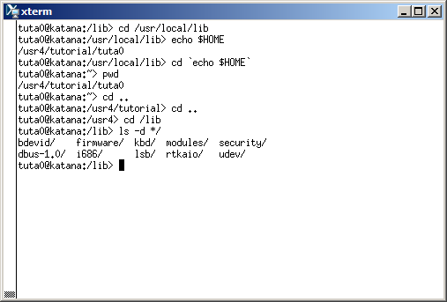
Navigating the File System
Moving around the file system using the cd command

Slide 38
Modifying the Linux File System
More useful commands
cd (also takes you to your home directory like cd ~)
mkdir test
echo ‘Hello everyone’ > test/myfile.txt
echo ‘Goodbye all’ >> test/myfile.txt
less test/myfile.txt
mkdir test/subdir1/subdir2 (FAILS)
mkdir -p test/subdir1/subdir2 (Succeeds)
mv test/myfile.txt test/subdir1/subdir2
rmdir test (FAILS)
rm –Rv test (Succeeds)

Slide 39
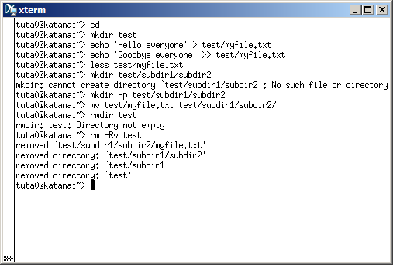
Modifying the Linux File System
Demonstration of the mkdir, less, mv, rmdir and rm commands

Slide 40
The List Command
Useful options for the “ls” command:
ls -a List all file including hidden file beginning with a period “.”
ls -ld * List details about a directory and not its contents
ls -F Put an indicator character at the end of each name
ls –l Simple long listing
ls –lh Give human readable file sizes
ls –lS Sort files by file size
ls –lt Sort files by modification time

Slide 41
File System Ownership and Permissions
All files and directories have a individual and a group ownership.
All files and directories have read (r), write (w), and execute (x) permissions assigned as octets to the individual owner (u), the group (g) owner and all others (o) that are logged into the system.
You can change permissions if you are the individual owner or a member of the group.
Only root can change ownership.

Slide 42

root
The root user is the master
Notes:
Tux image source: https://artsec.com/wp-content/uploads/2011/12/linux-root-account-security.png

Slide 43
File and Directory Ownership and Permissions
Try
cd
touch myfile (create file)
mkdir mydir (create directory)
ls –l myfile (examine file)
ls –ld mydir (examine directory)
chmod g+w myfile (add group write permission)
ls –l myfile
chmod ugo+x myfile (add user, group and other execute permission)
ls –l myfile
chmod ugo+w mydir (add user, group and other write permission)
ls –ld mydir
chmod a-w (a=ALL, remove user, group and other write permission)

Slide 44
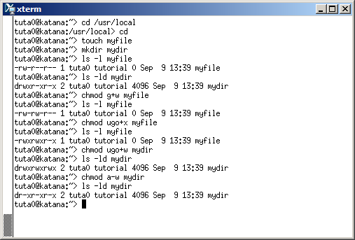
File and Directory Ownership and Permissions
Examining and changing file and directory permissions

Slide 45
Editing Output Lines With awk (see awk-tutorial.pdf)
Syntax:
BEGIN { Actions}
{ACTION} # Action for every line in a file
END { Actions }
Try
ls –l /usr
ls –l /usr | awk ‘{print $9 “\t” $5}’
ls –l /usr > usr.txt
awk ‘print $9 “\t” $5}’ usr.txt (gives same results as 2nd command line, but awk is acting on a file instead of saved output)
ls –lh /lib | awk ‘{printf “%20s\t%s\n”,$9,$5}’
ls –l /lib | awk ‘BEGIN {sum=0} {printf “%20s\t%s\n”,$9,$5; sum+=$5} END{sum/=1000000; printf “\nTotal: %d GB\n”,sum}’

Slide 46
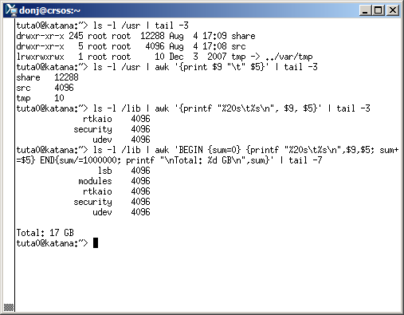
Editing Output Lines With awk
Output from awk commands

Slide 47
Editing Output Lines With sed
sed replaces one substring with another
sed operates on every line in a file or processes every line piped into it
sed matches patterns using regular expressions (See regular-expressions.pdf cheat sheet)
Common regular expression metacharacters:
. – any character
? – quantified zero or one
* - quantifier none or more
+ - quantifier one or more
^ - beginning of line
$ - end of line
[XxYy] – character class matching upper or lower case “X” or “”Y”

Slide 48
Editing Output Lines With sed – continued (see sed-tutorial.pdf)
Try
echo “The rain in Spain stays mainly in the plain.” > easy_sed.txt; cat easy_sed.txt
sed –i.bak ‘s/rain/snow/;s/Spain/Sweden/;s/plain/mountains/’ easy_sed.txt; cat easy_sed.txt
ls -l /lib | awk 'BEGIN {sum=0} {printf "%s\t%s\n",$9,$5; sum+=$5} END{printf "\nTotal: %d\n",sum}' | sed -e 's/\.so\(\.[0-9]*\)*//' | less (challenge: get rid of soname extension)
ls -l /lib | awk 'BEGIN {sum=0} {printf "%s\t%s\n",$9,$5; sum+=$5} END{printf "\nTotal: %d GB\n",sum}' | sed -e 's/\.so\(\.[0-9]*\)*//' | awk '{printf "%20s\t%s\n",$1,$2}‘ | less (pretty print)

Slide 49
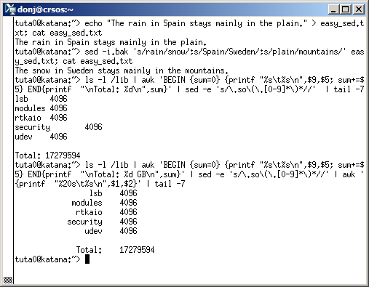
Editing Output Lines With sed
Output from sed commands

Slide 50

Editing Files with Emacs and Vim
You don’t have to take sides and there is always “nedit”
Notes:
Image source: http://vorn.co.za/blog/wp-content/uploads/2010/12/emacs-vs-vim2.jpg

Slide 51


Editing Files with Emacs and Vim
Cheat sheet: emacs.pdf
Movement: <C-b>,<C-n>, <C-p>,<C-f>,<M-b>,<M-e>,<C-a>,<C-e>,<M-’<‘ >,<M-’>’ >,
Change/Delete/Replace: <C-d>,<M-d-esc>,<M-d>,<C-kk>,<C-d’char’>,<Insert>
Copy/Paste: <C-space>,<C-y>,<C-_>,<M-w>,<C-aky>
Search/Replace: <C-s enter>,<C-s>,<C-r>,<M-x, ‘replace-string’<CR>’srchstr’<CR>’replacement’<CR>
Save/Quit: <C-xs>,<C-xw>,<C-xc,’n’,’yes’<CR>>
Cheat sheet: vim.pdf
Movement: <h>,<j>, <k>,<l>,<b>,<e>,<0>,<$>,<gg>,<G>
Change/Delete/Replace: <x>,<cw>,<dw>,<dd>,<r>,<R>
Copy/Paste: <v>,<P>,<u>,<y>,<yy>
Search/Replace: </>,<n>,<N>,<:%s/’regex’/’replacement’/g>
Save/Quit: <:q>,<:w>,<:q!>
Emacs – Control Keys
C=Ctrl and M=Meta (Alt)
Vim – Modal
Cmd, Insert, and Visual
Notes:
Vim logo source: http://blog.tuxforge.com/wp-content/uploads/2011/08/vim-editor_logo.png
EMACS logo source: http://upload.wikimedia.org/wikipedia/commons/thumb/5/5f/Emacs-logo.svg/600px-Emacs-logo.svg.png

Slide 52

Mission Possible: Editing Files with Emacs and Vim
Someone has corrupted Edgar Allen Poe’s poem, “The Raven.” Your mission, should you decide to accept it, is to repair the damage with emacs or vim and then confirm with the “diff” command. Hint: Also use diff to find corruption.
emacs –nw bad-the-raven.txt
or
vim bad-the-raven.txt
After editing and saving your file, confirm you work with:
diff bad-the-raven.txt good-the-raven.txt
Notes:
Mission Impossible image source: http://cdn.screenrant.com/wp-content/uploads/Mission-Impossible-5-Tom-Cruise.jpg

Slide 53


Finis
Notes:
“My Fair Lady” image source: http://www.englishspeakingsuccess.com/yahoo_site_admin/assets/images/aud_rain.251163135_std.jpg
Tux source: http://www.ozsticker.com/577-1130-thickbox/cane-tux-linux-penguin.jpg

